Slide 1
Building Simple Neural Networks
Class 2.1

Slide 2
Pre-read
Regularization
Adam and AdamW

Slide 3
Agenda — Class 2.1: Building Simple Neural Networks
Structure of a Neural Network
Layers, activations, forward pass, backward pass
Loss Functions
MSE, cross-entropy, supervised vs self-supervised signals
Optimization & Training Dynamics
Mini-batch SGD
Learning rate schedules
Implementing forward/backward pass
Regularization Techniques
Weight decay
Dropout
Avoiding overfitting vs underfitting
Optimizers in Practice
SGD
RMSProp
Adam and AdamW
Weight Initialization & Variance Propagation
Xavier / Kaiming initialization
Stable forward & backward variance
PyTorch Examples
Manual backprop implementation
Dataset/DataLoader usage
Fitting a simple model (sin(x))
Homework & Self-Study

Slide 4
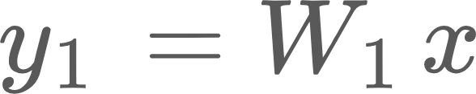


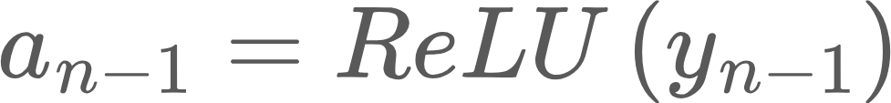
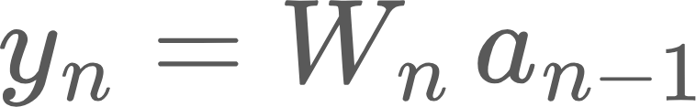




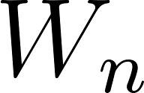



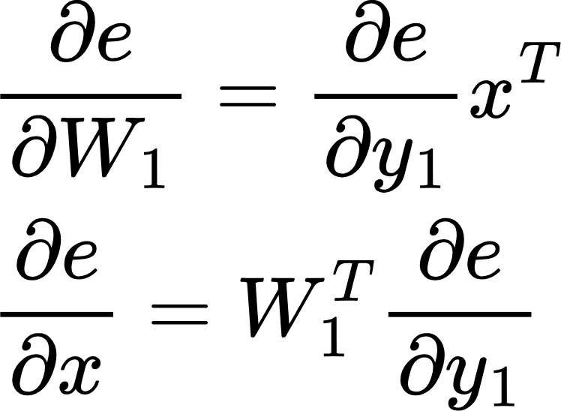
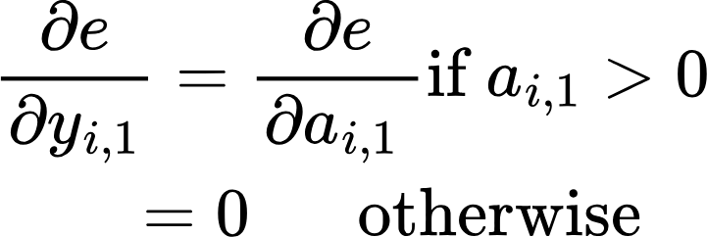
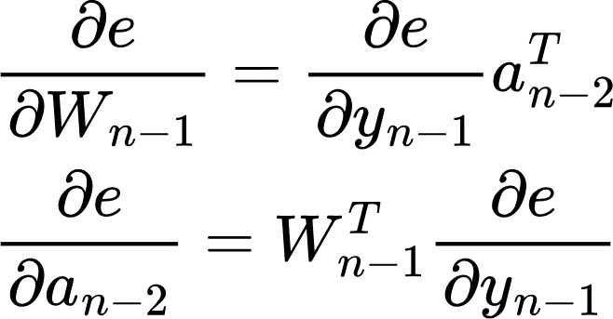
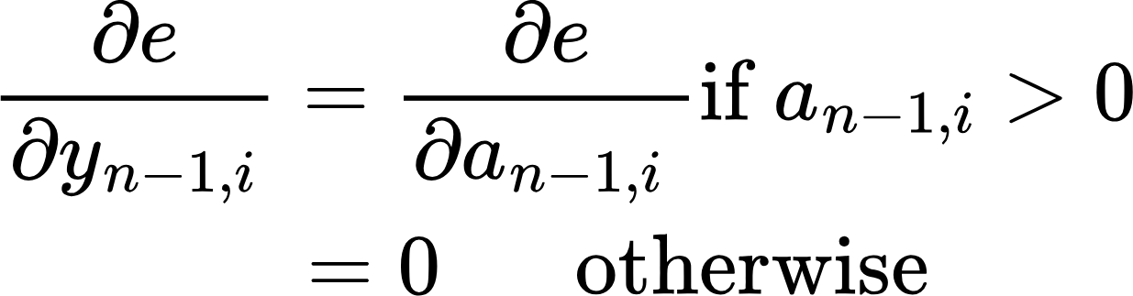
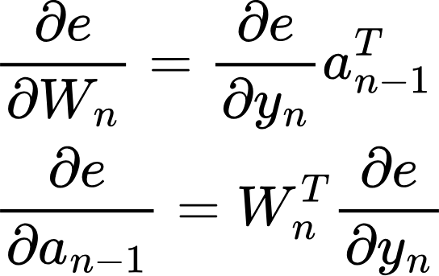
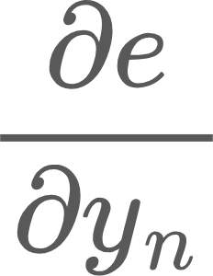
Structure of a neural network
Forward Pass or Inference
labels
ReLU
ReLU
Loss function (L)
…
Error
e = L(y)
Layer 1
Layer n-1
Layer n
Backward pass
(Training)
No parameters!
Notice we need the output of the previous layer in the backward pass!
Sent back to previous layers
Used to update the weights of this layer

Slide 5
Loss functions
How is groundtruth obtained?
Supervised: groundtruth by human labelers (eg., objects in an image)
Weakly supervised: Is the network output correct or not?
Self-supervised: Groundtruth inherent in the training data, but hidden from the model. Eg., predicting masked words in a sentence
Groundtruth
Loss function (L)
Network Output
Error
e = L(y)
Loss function depends on the task
Mean square error for regression task
x-Entropy loss for classification

Slide 6
Stochastic Minibatch Gradient Descent
How do we select the batch size?
Say we have n data points
1<B<n
Select a subset of the dataset at every iteration (without replacement). Calculate gradient and update weights. Do until we sweep through the entire dataset
Best of both worlds. Stable gradients, lower compute
Mini-batch gradients are unbiased estimators of the full gradient.
Variance of gradients decreases with larger batch size
B=1
Select a random point from the dataset (without replacement)
Calculate gradient and update weights
Problem: Gradient is very noisy
B=n
Select the entire dataset at every iteration
Calculate gradient and update weights
Problem: Large matrices, compute heavy
n
Sample B=m at each iteration. A sweep through the entire training dataset is called an epoch. Number of iterations in an epoch: n/B, assuming B divides n

Slide 7
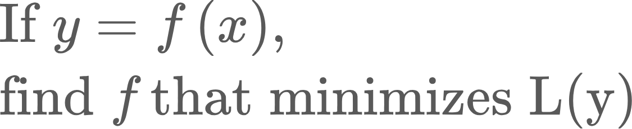
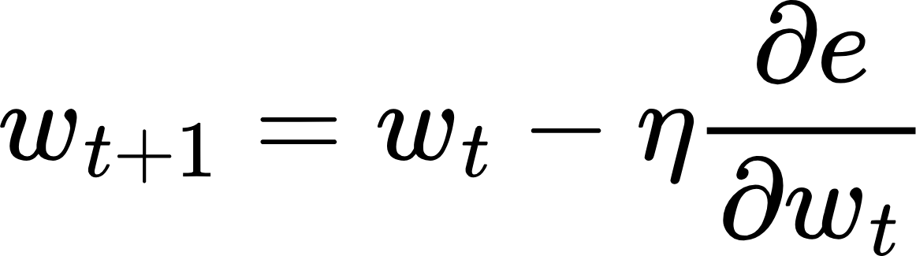
Updating Weights..
We calculated all these gradients.. Now what?
Recall the original optimization problem..
We modeled the unknown function f as a neural network, because neural networks can model any arbitrary function. Finding f means finding the weights of the network that minimize the loss function. We calculated the gradients so we know which direction to move the weights.
Learning rate.. This should get smaller as we get closer to the minimum

Slide 8
Learning rate schedule
Recall that in optimization, the learning rate controls the size of the step at each iteration. Generally, the optimization landscape becomes shallower near the minimum.. Thus, we should lower the learning rate as optimization proceeds, otherwise the iterates might bounce along the optimization function rather than settling in.

Slide 9
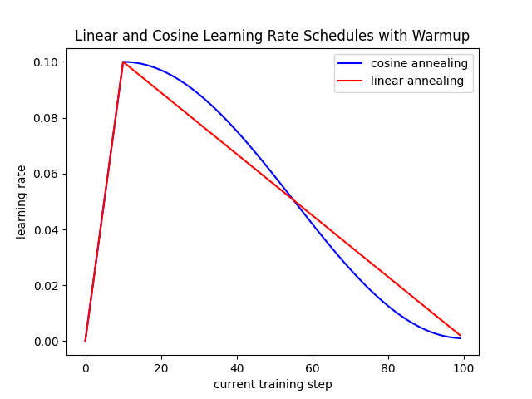
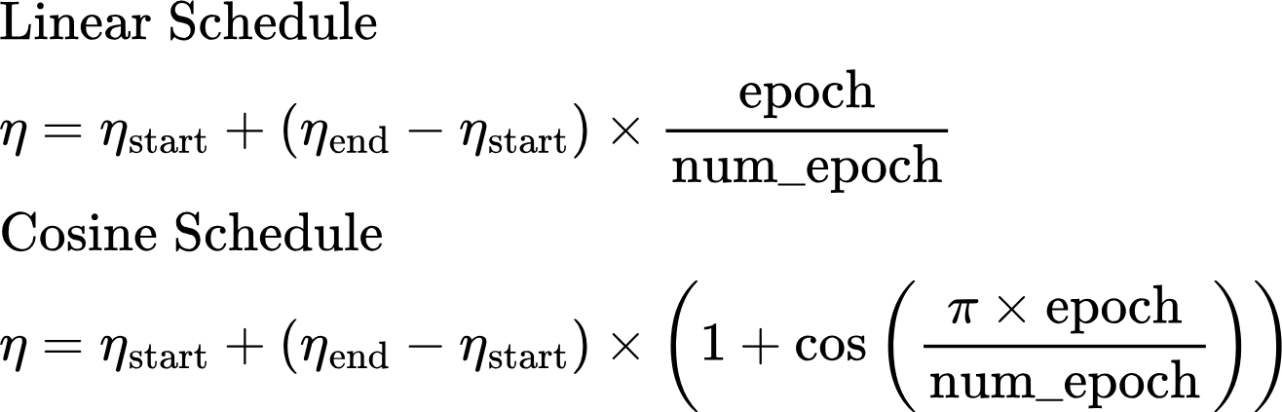
Learning rate schedule
In deep learning libraries, learning rate is generally adjusted after each epoch. The trajectory of the learning rate from its starting value to final value is called learning rate schedule. Some examples are:
There are several more eg., exponential decay
Learning Rate Warmup: For large NNs, learning rate is warmed up from a small starting value to base value, and then decayed following a schedule
In large networks, groups of layers can have their own learning rates
Cosine schedule paper

Slide 10
Training process
In every epoch
Sample a minibatch from the training data
Run forward pass and calculate network output
Compare network output to groundtruth, compute loss
Run backward pass, compute gradients
Run optimizer, where network parameters are adjusted
Calculate performance on validation data
Repeat until performance metric on validation data stops increasing or some other criteria is met
Evaluate performance on test data
Training data: portion of the data used to fit the model’s parameters
Validation data: used during model development to evaluate generalization while tuning model. Model is not trained on this data
Test data: used only at the very end, after all training and hyperparameter tuning are complete, to produce an unbiased estimate of the model’s true performance

Slide 11
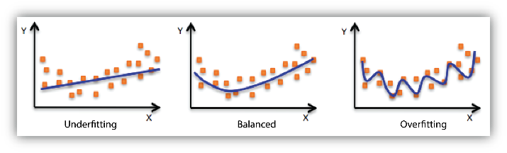
Regularization
Regularization means imposing constraints on the optimization process to meet certain desirable properties. Eg.,
It is a good idea to keep the weights of a Neural Network small (accomplished by weight decay)
Large weights amplify the magnitude of activations and gradients, making the model more sensitive to small input changes and more prone to overfitting → risk of overfitting.
Small weights encourage simpler functions, which often generalize better.
The network shouldn’t overly rely on a small number of neurons (accomplished by dropout)
Reduce the chance of overfitting
Underfitting: The model is too simple to capture the underlying structure or patterns in the data. Training and validation loss are both high
Overfitting: The model memorizes the training data, rather than learning its underlying structure. Training loss low, but validation loss high. Can be mitigated by lowering number of model parameters, increasing size of training data, regularization, early stopping

Slide 12
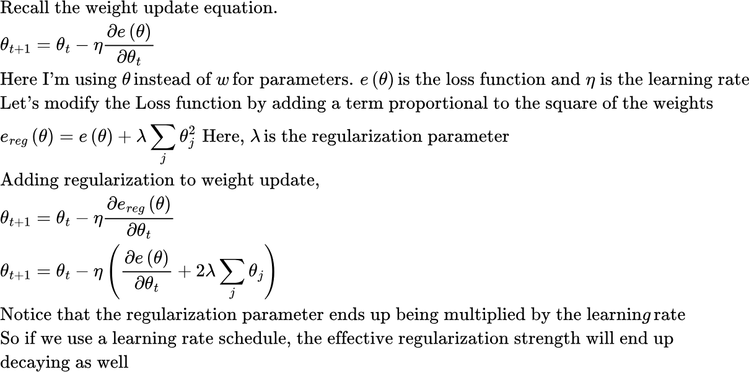
Regularization: Weight Decay
Generally, regularization is not applied to bias parameters. This is because bias often represents a "baseline prediction" (e.g., class prior probability). Regularizing it could distort this baseline estimate.
Note: lambda is called “weight decay” in Pytorch..
Notes:
Thinking of weights as the “slopes” of lines and biases as the “intercepts.”
Penalizing slopes keeps the line from becoming too steep (simpler model).
Penalizing intercepts just pushes the line toward the origin, which doesn’t really fight overfitting — it just shifts everything awkwardly.
If you are curious: Fixing Weight Decay Regularization in Adam” (Loshchilov & Hutter, 2017)

Slide 13
Regularization: Dropout
Another regularization method is Dropout, where during training, we randomly “drop” (set to zero) a fraction of neurons in a layer. Setting to zero means setting the corresponding activations to 0. The subset of neurons set to 0 is called “dropout mask”. This mask changes every training iteration.
The intuition is that Neurons can’t rely on specific other neurons being present and thus learn more independent, robust features.
Dropout used to be quite popular in older networks to prevent overfitting, but less common in latest Transformer-based networks. This is because the size of training datasets is huge, and each training sample is only seen a small number of times, making overfitting is less of a problem. See this article (search for dropout)

Slide 14
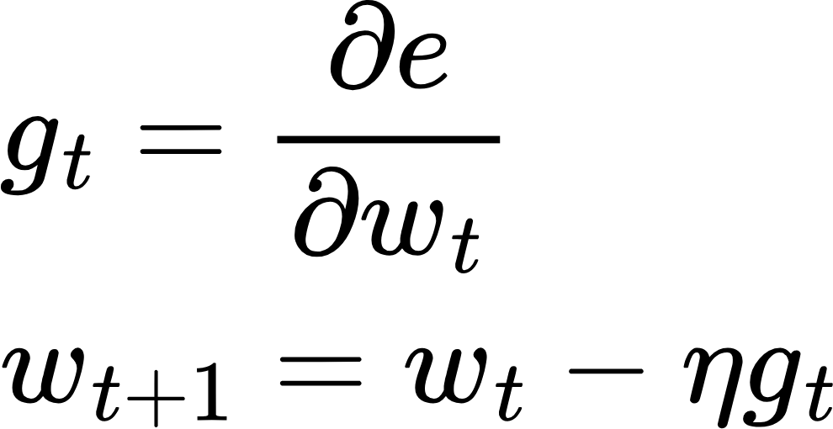
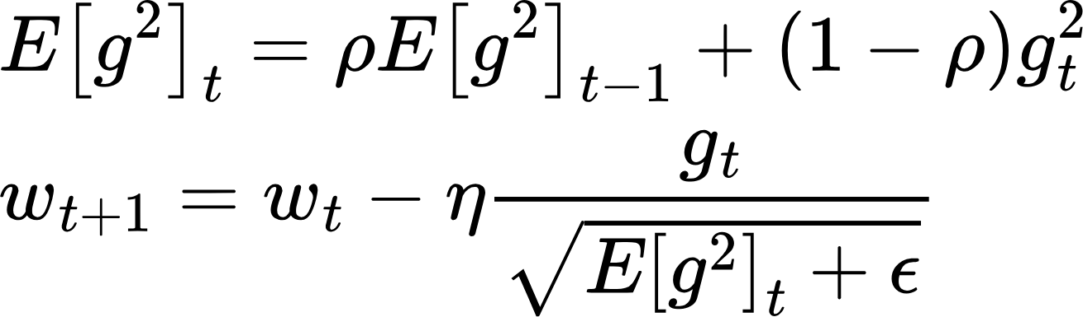
Optimizer
Optimizer: Module that updates network parameters using gradients calculated in the backward pass, applying regularization and learning rate schedule
SGD
RMSProp
All parameters are treated equally. Parameters that get large gradients should get smaller steps and vice versa
If a parameter receives large gradients, the denominator would grow large and step size would become smaller

Slide 15
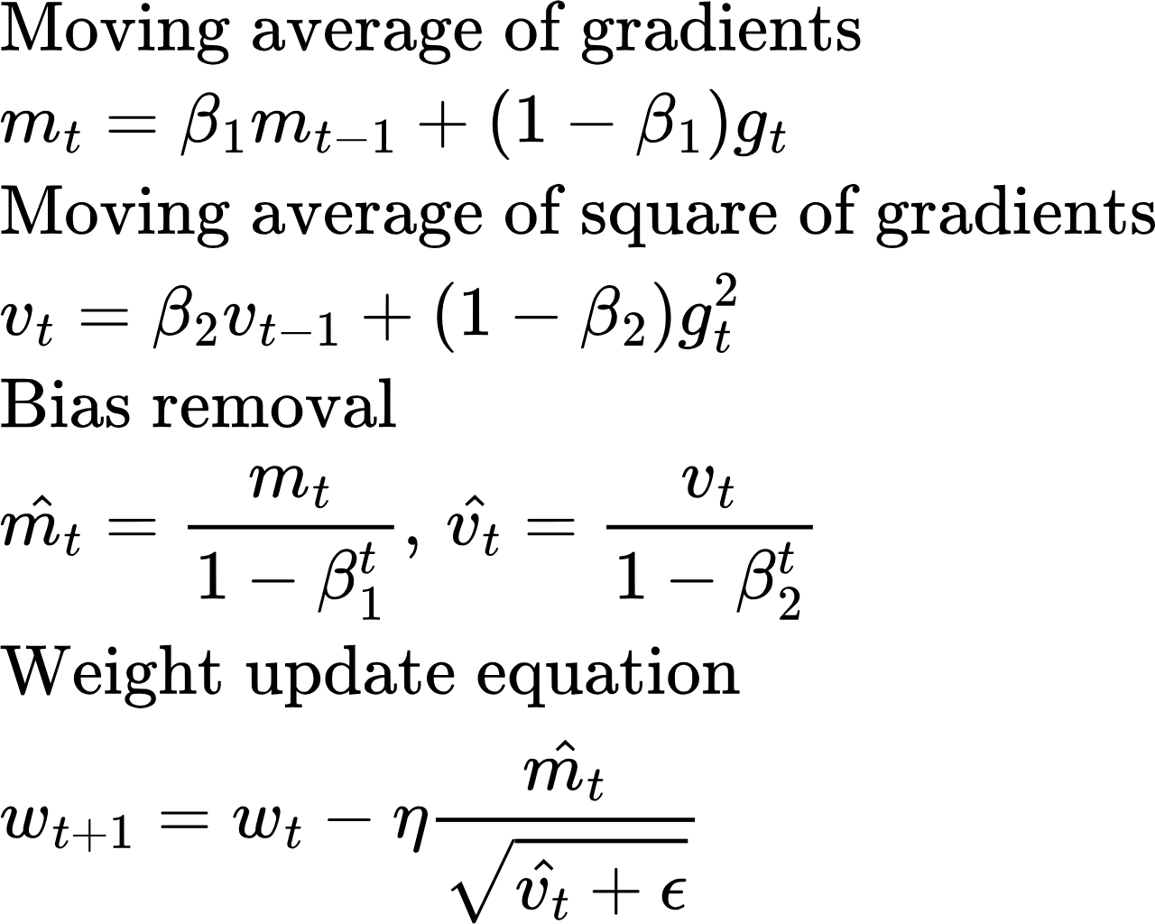
Optimizer : Adam
Adam: Most popular and successful optimizer
Uses moving average of the gradient
Since m_t, v_t are initialized to zero, they are biased towards 0 in the early time steps. Adam adds bias correction, which corrects for early underestimation
Adam

Slide 16
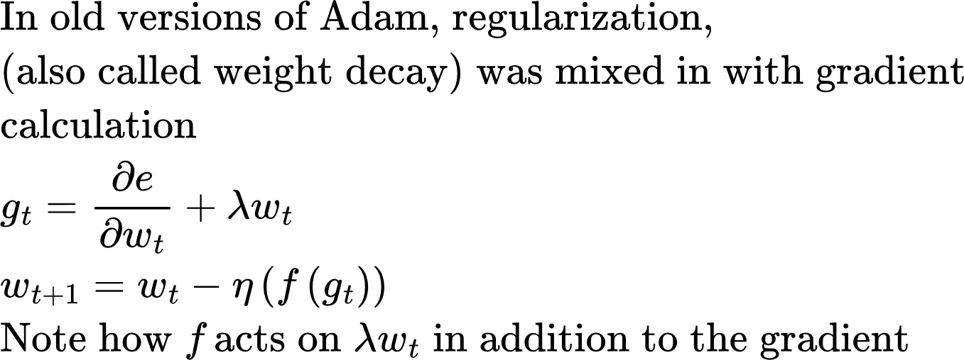
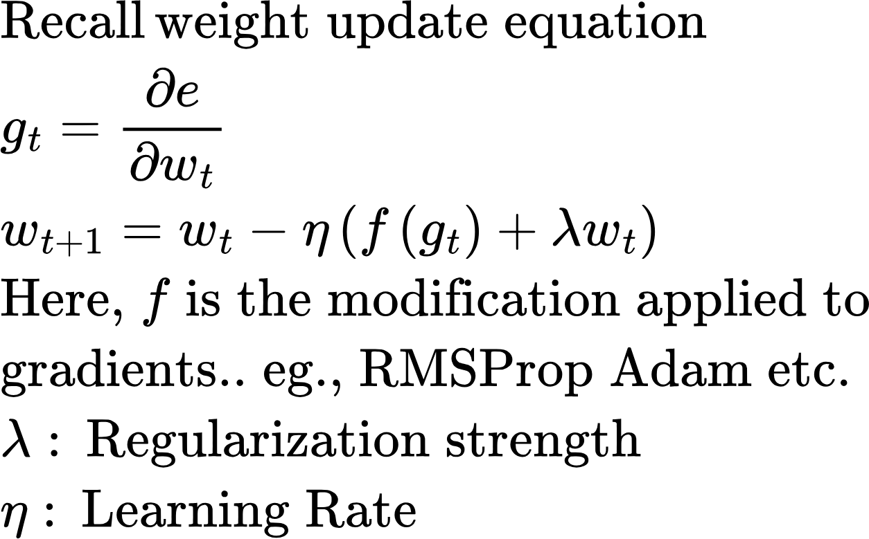
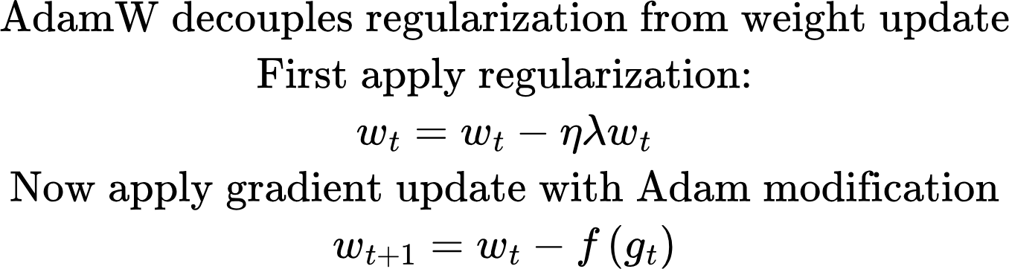
Optimizer
Adam vs AdamW

Slide 17
Hyperparameters
The initial value of these parameters is chosen by guesswork and set at the beginning of a training run.
A systematic exploration of the best value of these parameters for a given model is called Hyperparameter Tuning. More on that in a subsequent lecture

Slide 18
Code Example
Simple_nn1.py: Training a simple 1 layer network to predict sin(x)
Simple_nn2.py: Implementing the forward, backward pass, loss calculation and parameter update steps manually
Simple_nn3.py: Using Pytorch Dataloader and Dataset classes

Slide 19
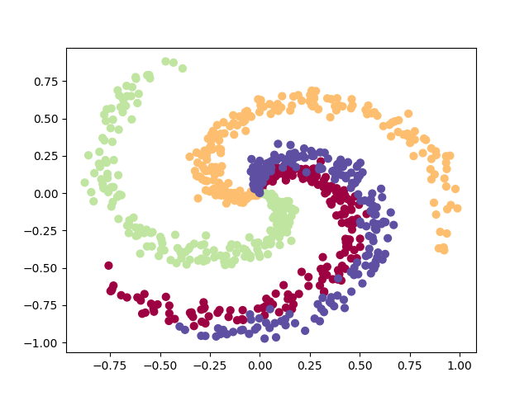
Self work: Classification Example--Spiral Dataset
Build a 3 layer network to classify points on the arms of a spiral dataset
spiral_arm_classification.py

Slide 20
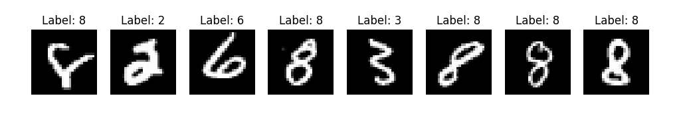
Self work: Classification Example--MNIST
Classifying digits in the MNIST dataset
mnist_pt.py
mnist.py

Slide 21




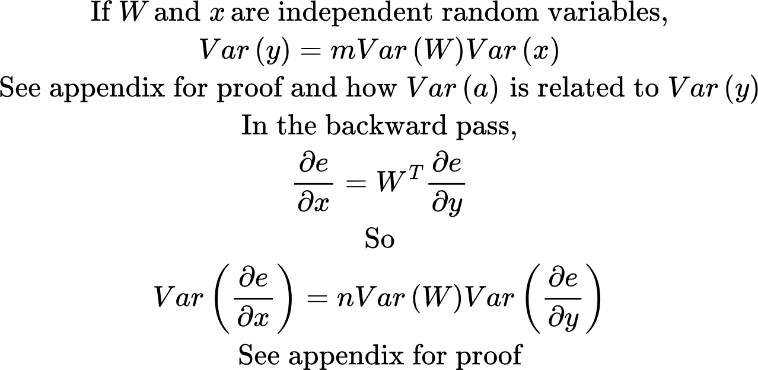
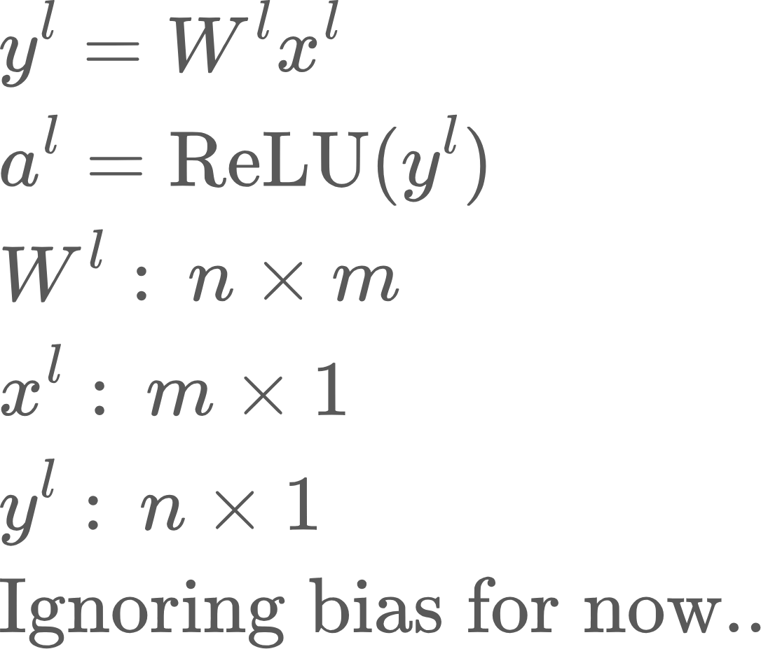
Weight Initialization
Consider layer l of a n layer network.
ReLU

Slide 22
Weight Initialization
When stacking many layers, we want to avoid exploding or vanishing activations in the forward pass and gradients in the backward pass.
In the forward pass, if weight initialization causes variance to grow with depth, activations in deeper layers will increasingly spread — some exploding to large values, others becoming zero — which destabilizes training.
In the backward pass, some gradients become very large (remember, gradients are proportional to the activations), resulting in unstable parameter updates, and therefore unstable trainings.
So, we want to keep the variance of activations and gradients stable during the forward and backward pass.This is accomplished by:
Initializing the weights the beginning of training in such a way that the variance of the input equals that of the output for each layer, both during forward and backward pass. Because variance is a measure of the spread of a distribution, bounding the variance bounds the probability of some activations or gradients becoming very large
Normalizing the mean and variance after each layer

Slide 23
Homework
Q4: Run simple_nn2.py with default parameters. Record the final value of the loss function. Also plot the loss function history to see how it changes
Change the optimizer from ‘adam’ to ‘simple’. Run the code. Surprised?
Switch the optimizer back to Adam and vary the size of hidden layer: [20, 50, 100, 150], learning scheduler to linear
Now change the non-linearity from ‘relu’ to ‘swish’. What do you observe
Notice that you are effectively doing manual hyperparameter tuning!
Record the loss progression for each of the above cases and compare the loss progression curves. You’ll need to write the loss_func_history array to disk and write a separate program to compare the loss function across runs..
Isn’t a pain to compare the output of these experiments? Wouldn’t it be nice if we could somehow record the output of each experiment and compare across runs?
Run simple_nn2.py in a debugger and step through forward and backward pass code. Check the shape of the input/output tensors and how the code follows the math developed in the slides
In simple_nn2.py, generate test data from -3*pi to 3*pi and test the prediction of the trained network on this data. What do you observe? What do you learn from this?
Use the

Slide 24
Appendix

Slide 25
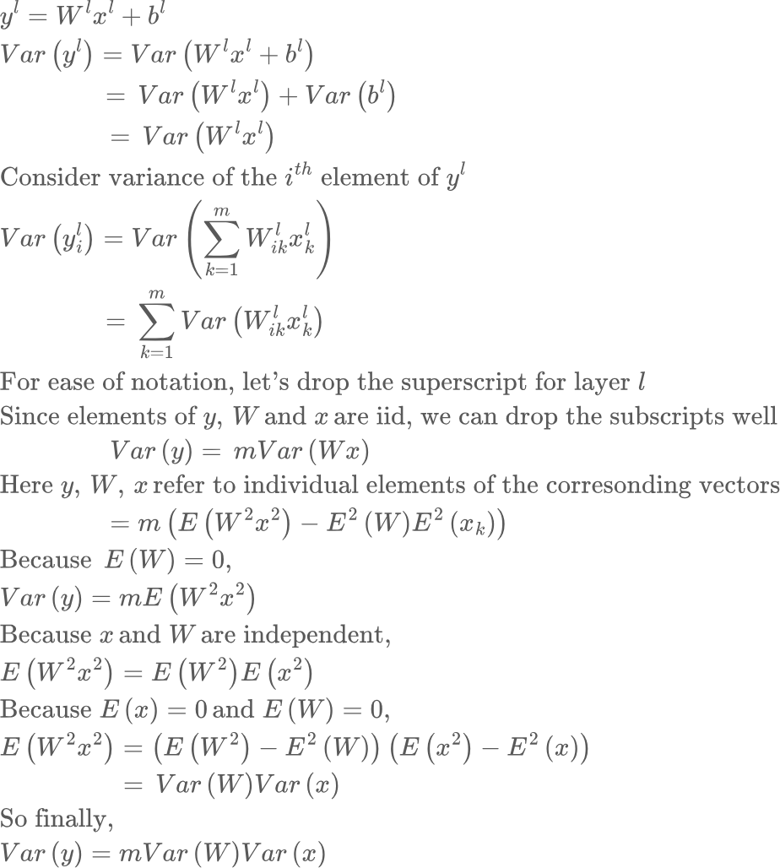
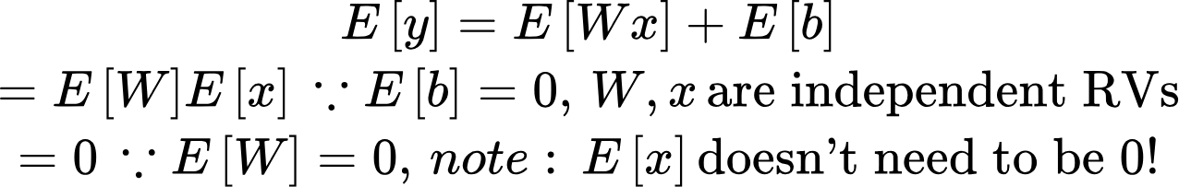
Variance propagation in the forward pass

Slide 26
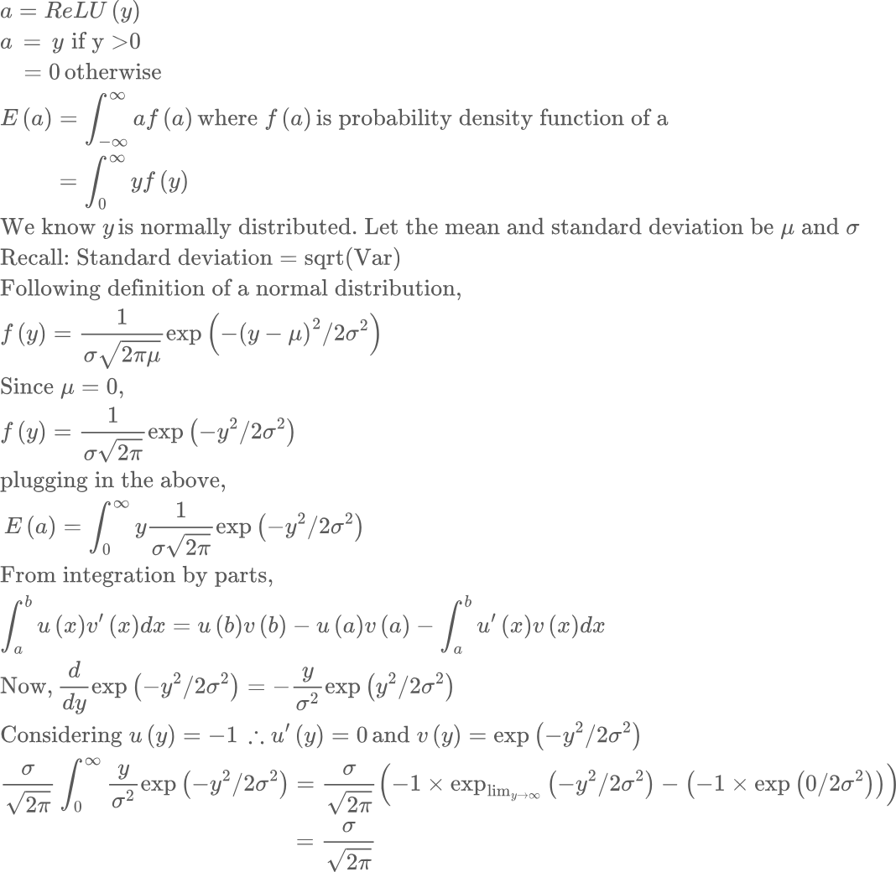
Variance propagation in the forward pass

Slide 27
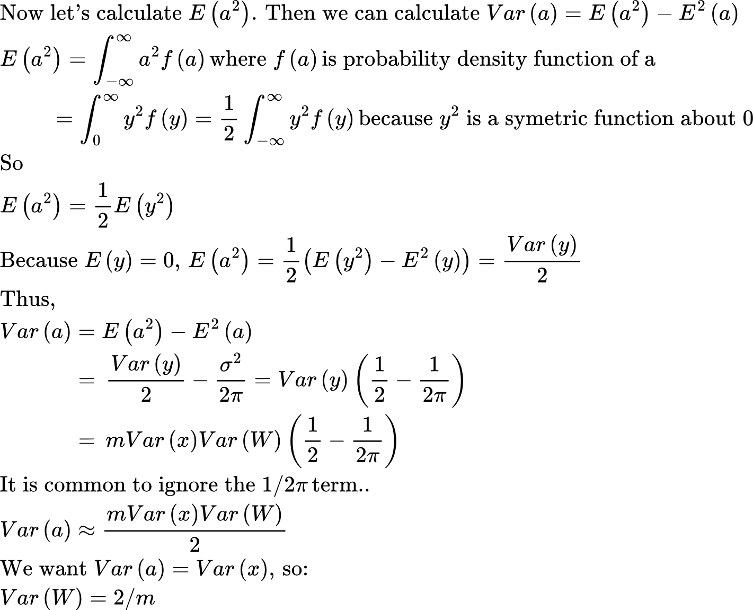
Variance propagation in the forward pass
See: variance_analysis.py

Slide 28
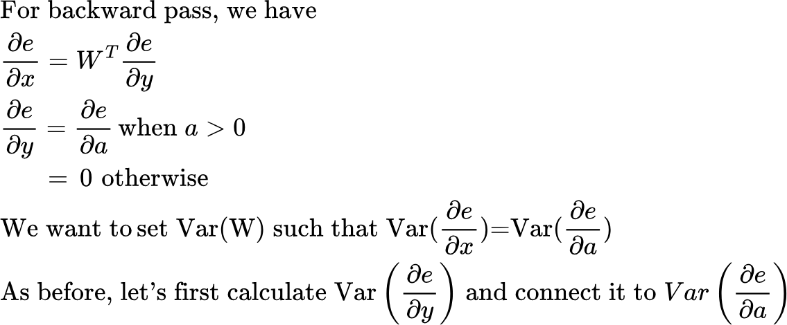
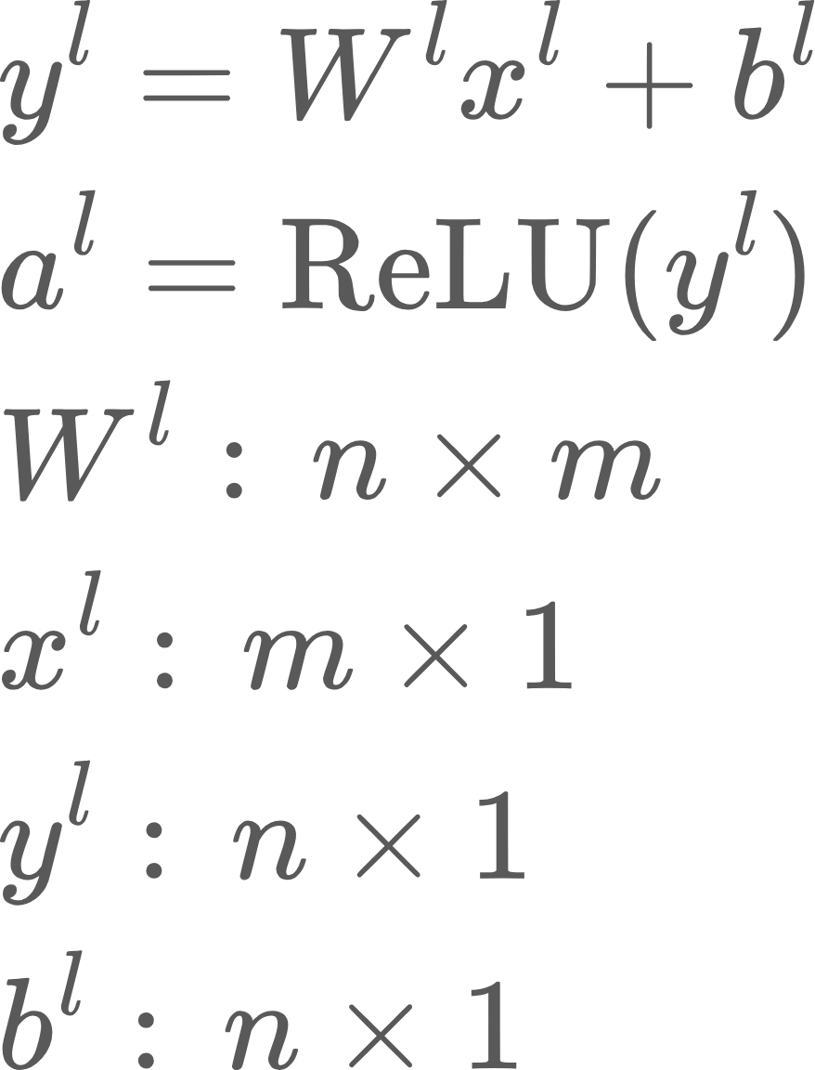
Variance propagation in the backward pass

Slide 29
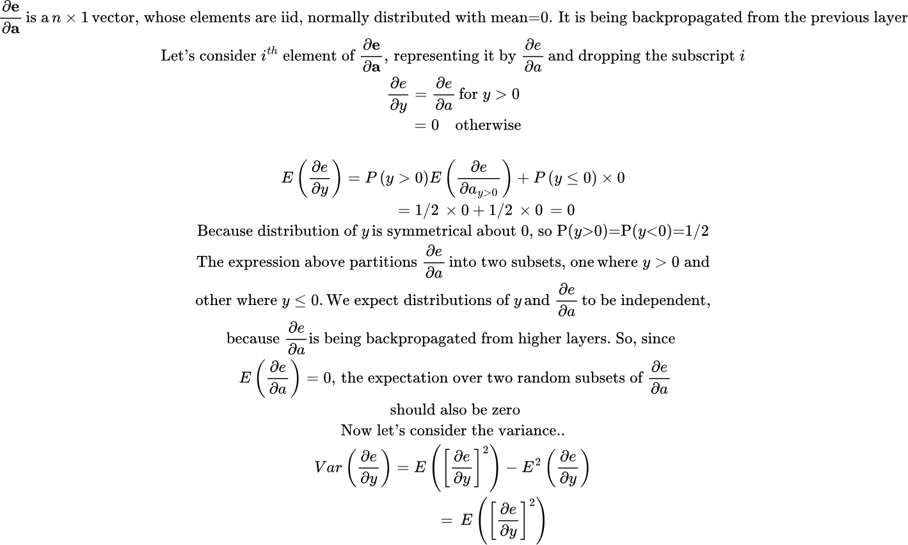
Variance propagation in the backward pass

Slide 30
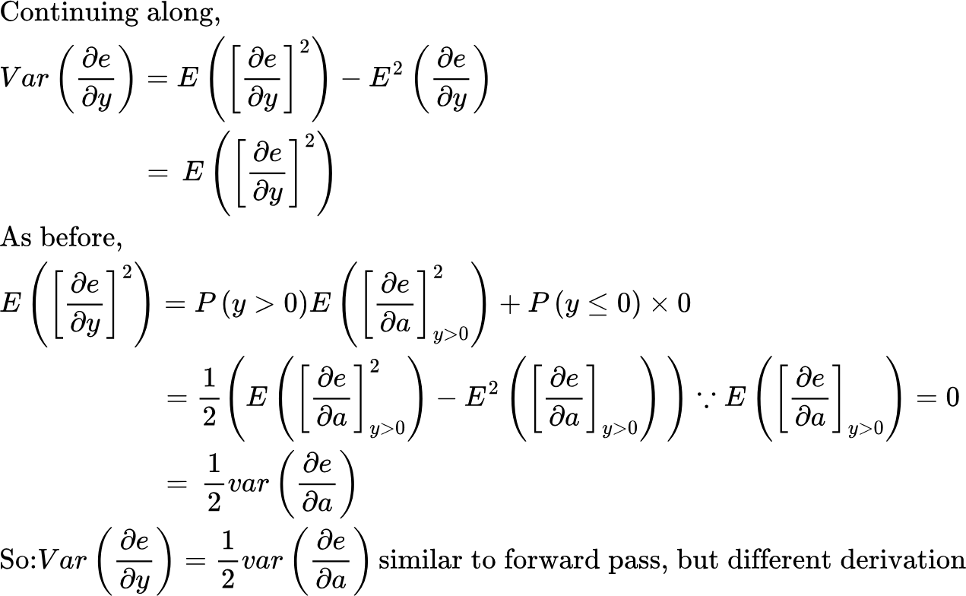
Variance propagation in the backward pass

Slide 31
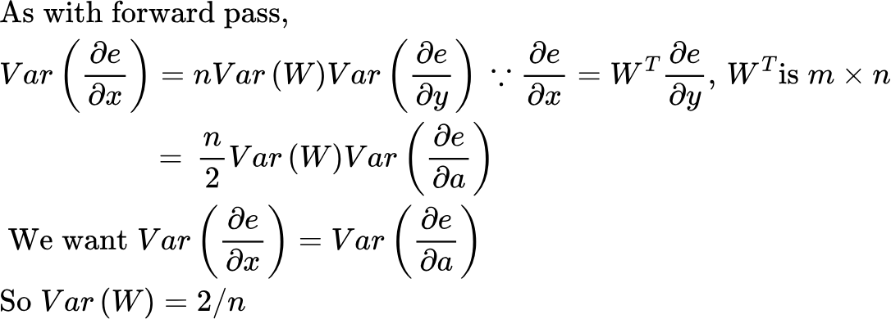
Variance propagation in the backward pass

Slide 32
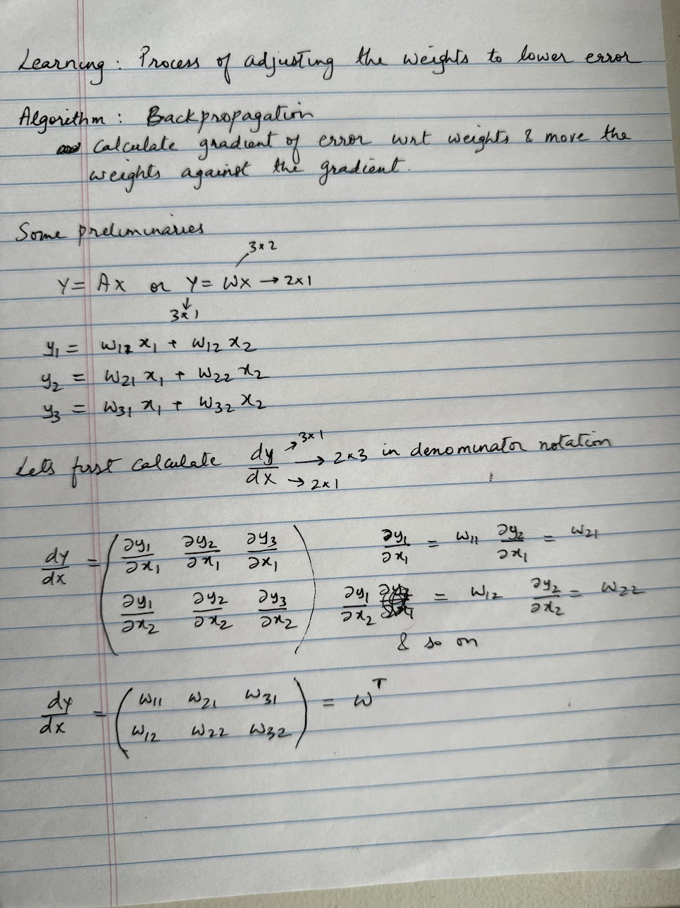
Backpropagation
Learning is the process of adjusting the weights of the layers in a network against the gradient.
This is done using an algorithm called Backpropagation.
Key idea is to calculate the derivative of the error against the parameters of the network, and move the parameters against the gradient to gradually lower the error, which directs the network’s output towards the desired output

Slide 33
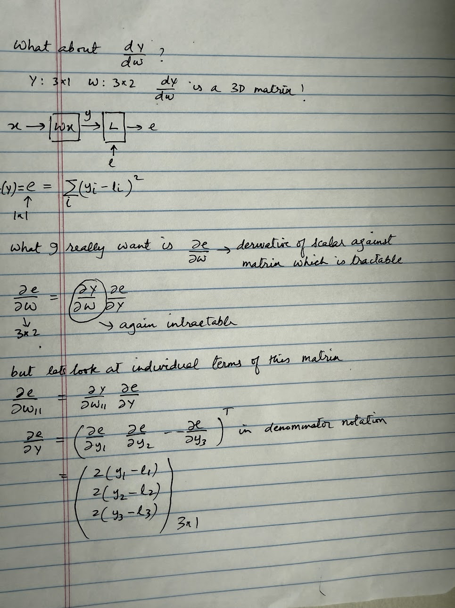
Backpropagation
Calculating the derivative of the error against the parameter matrix
Here our loss function is “squared error”
There are several loss functions:
Root Mean Square
Cross Entropy Loss
Contrastive Loss
We’ll look at these later in the course

Slide 34
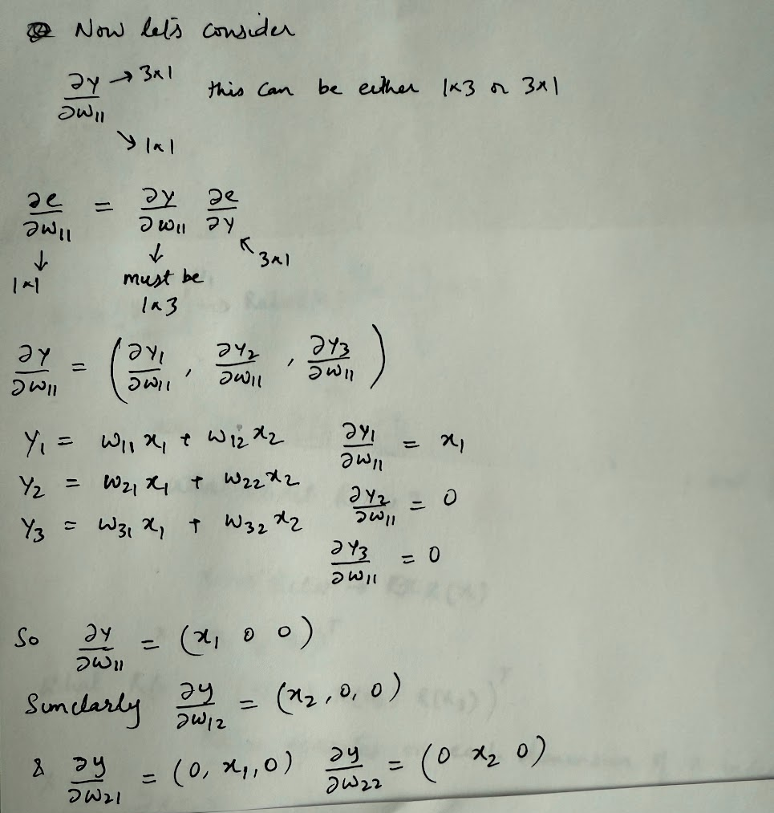
Backpropagation
Calculating the derivative of the error against the parameter matrix

Slide 35
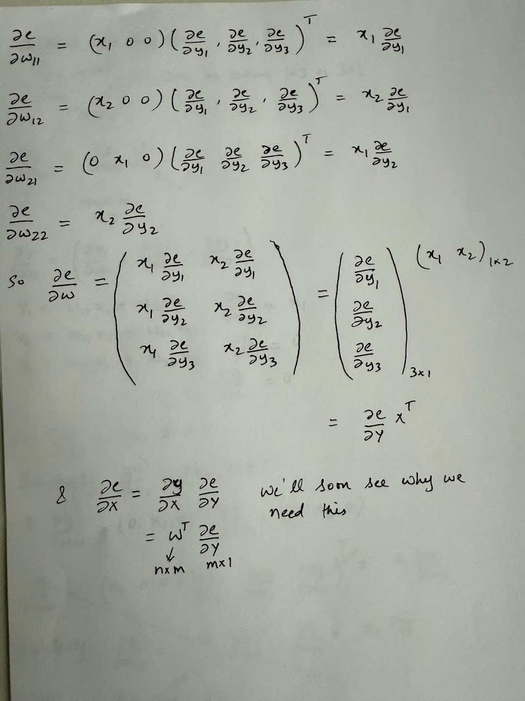
Backpropagation
Calculating the derivative of the error against the parameter matrix
This is a key result, because in a typical Transformer model, matrix multiplications account for a significant portion of the operations, often exceeding 80% of the total runtime.

Slide 36
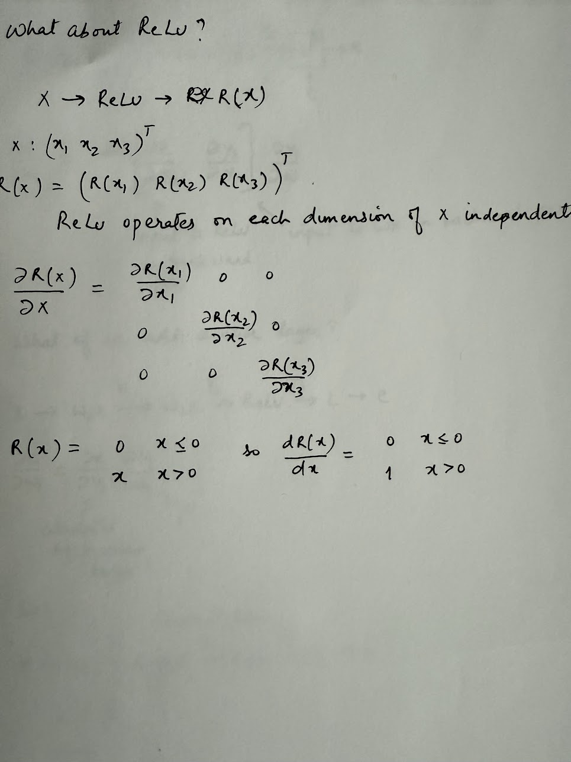
Backpropagation
Let’s look at ReLU now..
Note: In the derivation on the right, we are consider x as a 3*1 vector just as an example. In general, x would be a m*n matrix
Note: ReLU doesn’t have any parameters.. But we still need to calculate the derivative of its output against input

Slide 37
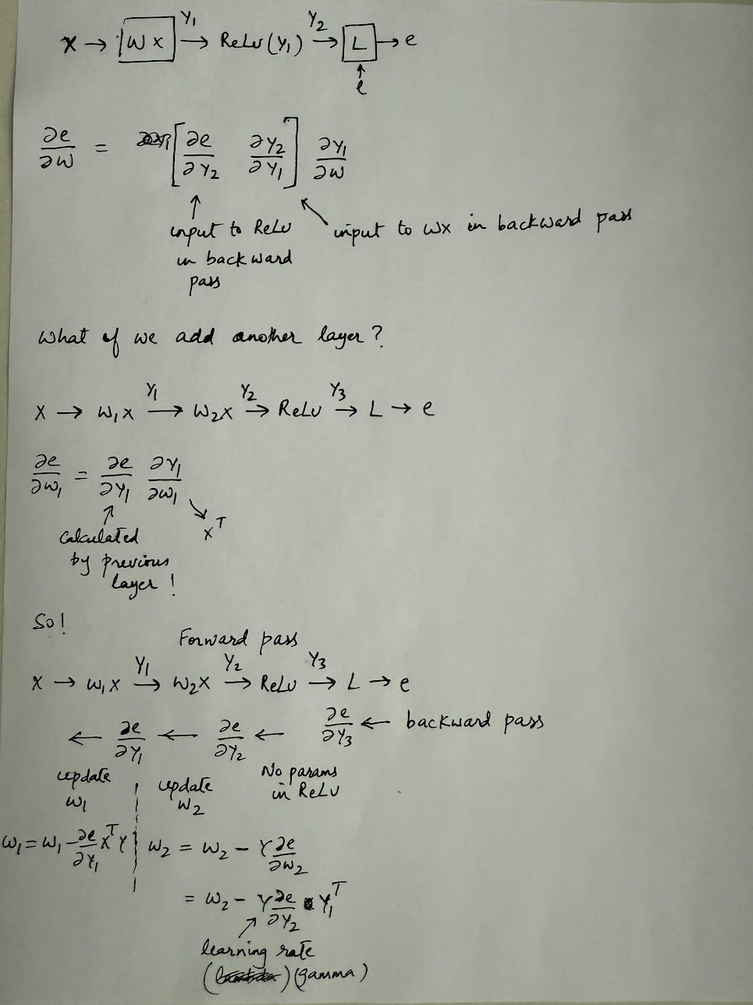
Backpropagation
Calculating the derivative of the error against the parameter matrix
Each layer uses the derivative of error against its output to calculate derivative of error against its parameters, and the derivative of error against its inputs, which is propagated back to the previous layer..

Slide 38
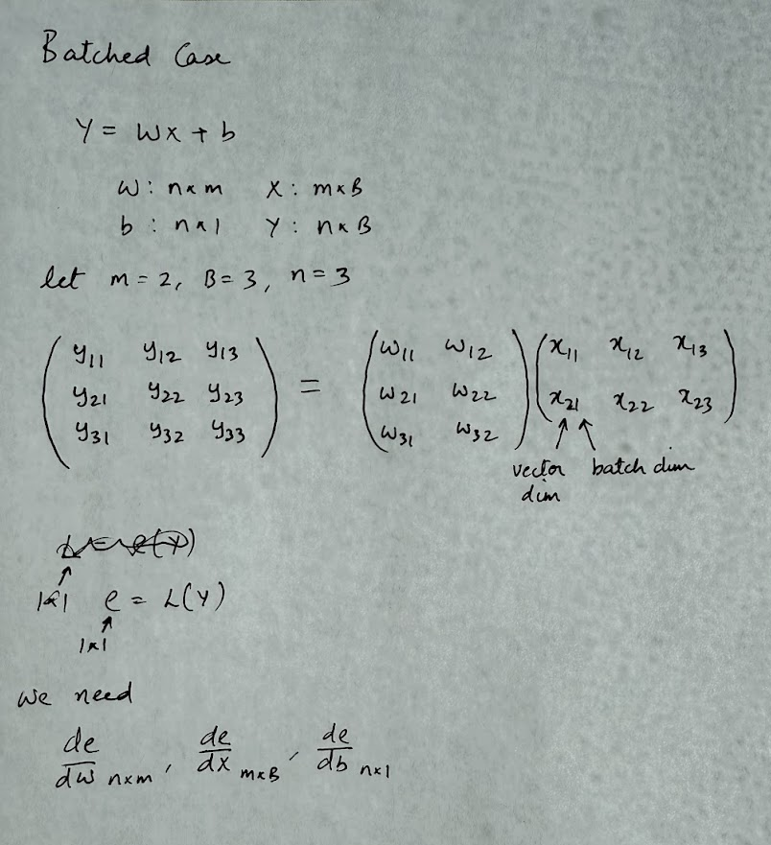
Backpropagation: Batched
So far, we calculated gradients for a single input. It is common to group the inputs into a batch. Let’s calculate the gradients for the batched case. We’ll also include the bias term now

Slide 39
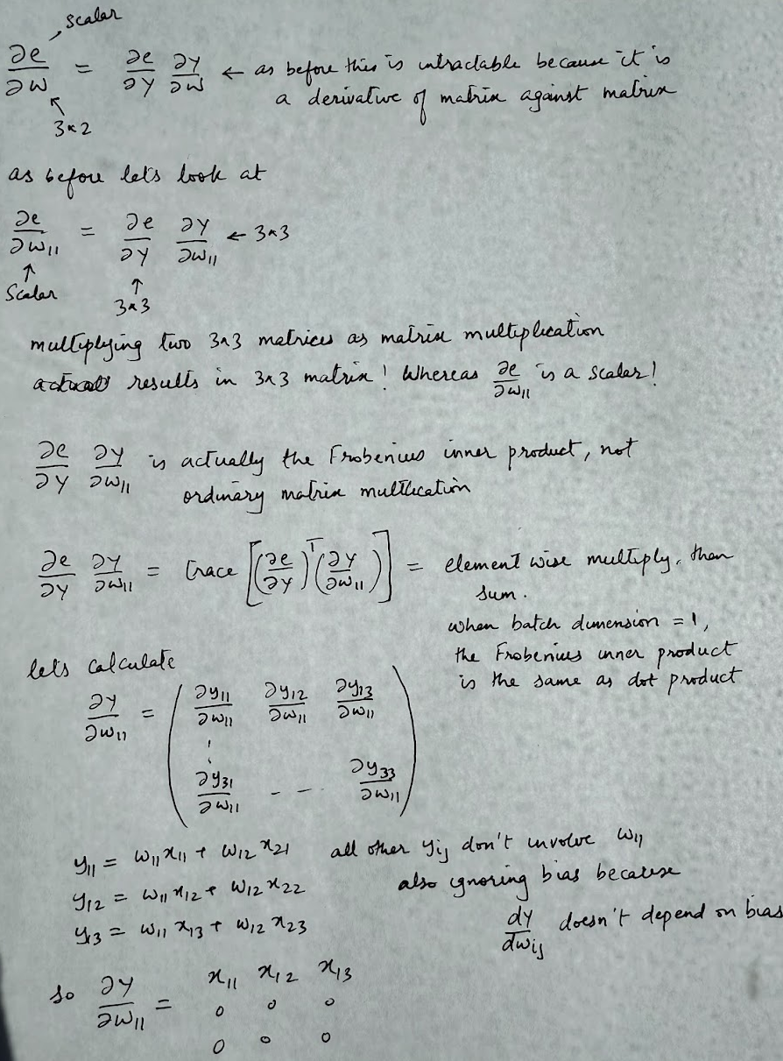
Backpropagation: Batched
Derivative of error against the weights

Slide 40
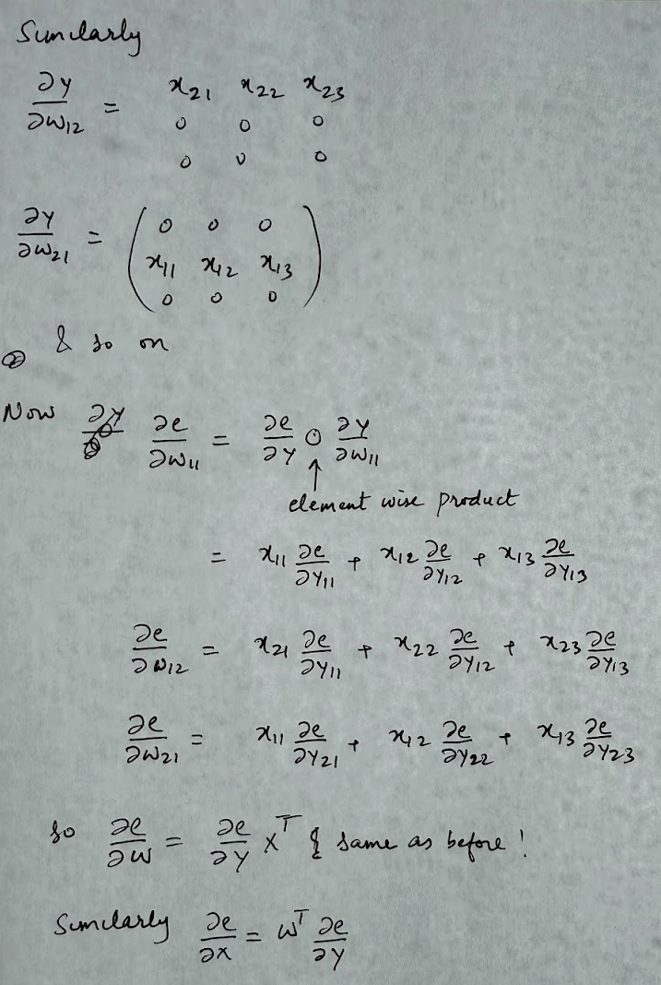
Backpropagation: Batched

Slide 41
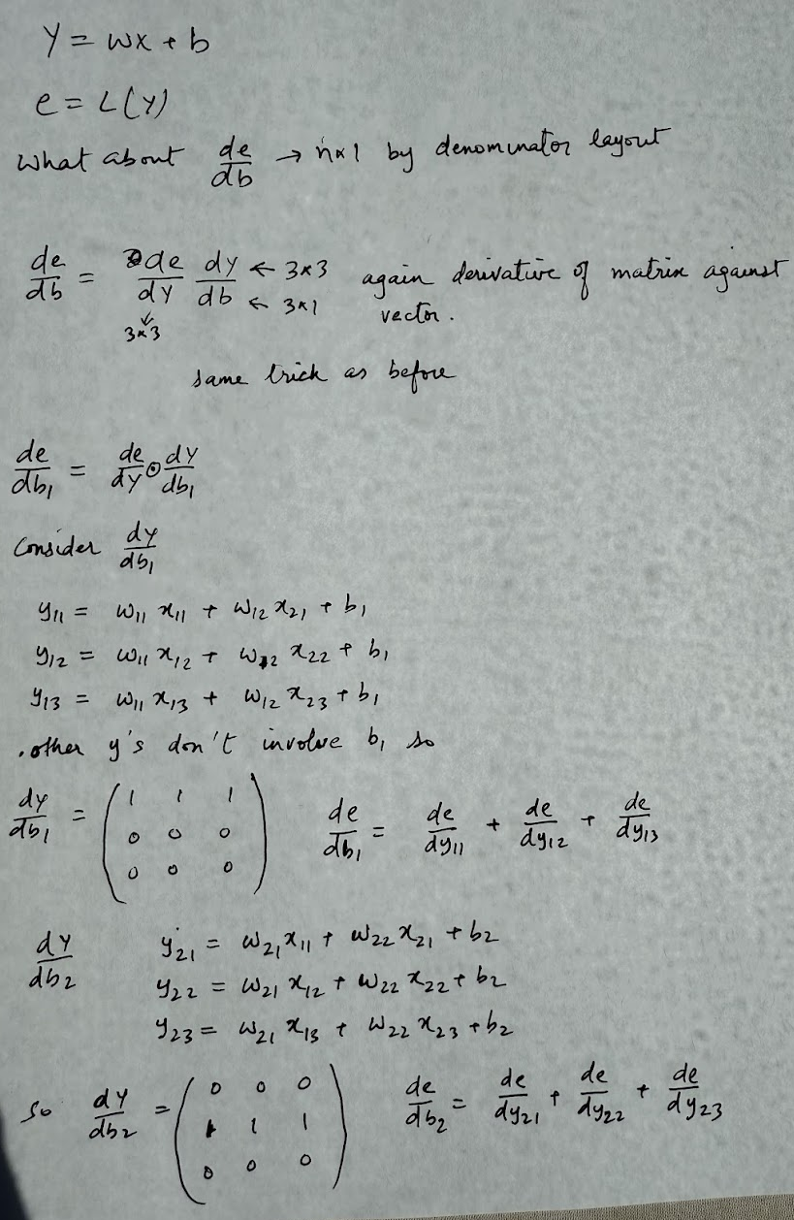
Backpropagation: Batched
Derivative of error against bias

Slide 42
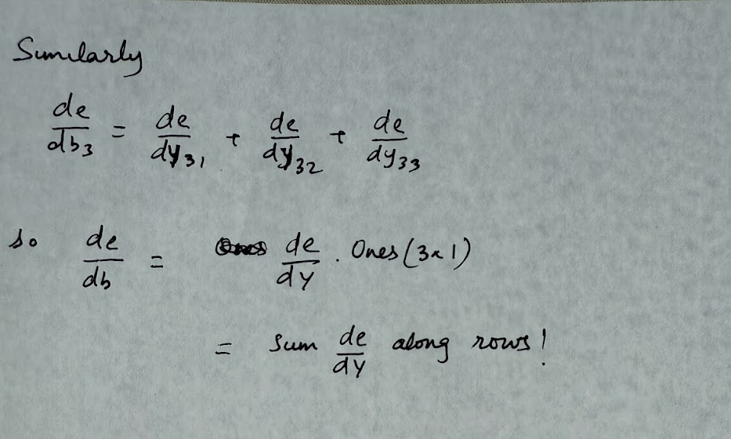
Backpropagation: Batched

